Slide 1

Basic Details of the Team and Problem Statement
Ministry/Organization Name/Student Innovation:
Ministry of Power
PS Code: 1301
Problem Statement Title: Language Translator
Team Name: Error Destroyers
Team Leader Name: Parth Manoj Sawant
Institute Code (AISHE):C-50450
Institute Name: A.P . SHAH INSTITUTE OF TECHNOLOGY
Theme Name: Smart Automation

Slide 2
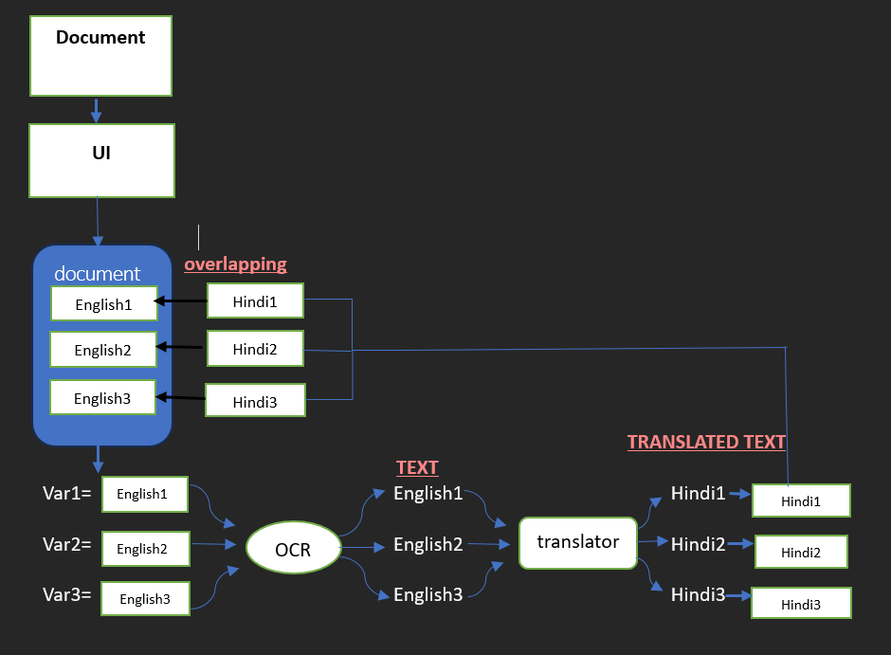

Idea/Approach Details
Upload an image of the document to the system.
Divide the image into text boxes based on fonts.
Store each text box as a variable.
Choose a specific text box for translation.
Extract text from the chosen box using OCR.
Translate the extracted text into Hindi.
Generate an image of the translated text.
Overlay the new image on the original document in the same location.
Result: A new document in the regional language (Hindi) with the same format as the original.
Technology Stack :-

Slide 3
Idea/Approach Details
Showstopper Feature: Real-time Language Detection and Translation
Integrate a real-time language detection mechanism into your system.
Here’s how it would work:
1. Automatic Language Detection: Upon image upload, the system auto-detects section languages.
2. Automated Translation: Sections not in the target language trigger OCR and translation.
3. Dynamic Overlay: Translated text is overlaid on the original image in real-time, creating a seamless translated document.
Benefits:
Time & Cost Savings: Quick, accurate translations without manual work.
Customization: Selective translation to meet client needs.
Efficiency: Real-time preview for easy review.
Accuracy: Reliable OCR and machine translation
The process majorly combines image processing, OCR, translation, and image manipulation to create a translated version of the document.
Use Case: Automated Legal Document Translation
User: Legal professionals and organizations.
Scenario: John, a legal professional, needs to translate English stamp papers into Hindi for clients efficiently.
Steps:
Upload Image: John uploads the English stamp paper image.
Auto Language Detection: System detects English.
Select & Crop: John chooses sections for translation.
OCR & Translation: Text is extracted and translated into Hindi.
Real-time Preview: John views translations on the original image.
Overlay & Download: John overlays Hindi text on the image and downloads the translated document.
.

Slide 4
Team Member Details
Team Leader Name: Parth Manoj Sawant
Branch : B.E Stream :CE Year : II
Team Member 1 Name: Atharva Sanjay Shelke
Branch : B.E Stream :CE Year : II
Team Member 2 Name: Prakriti Ashish Ranka
Branch : B.E Stream :CE Year : II
Team Member 3 Name: Gitanjali Vilas Salvi
Branch : B.E Stream :CE Year : II
Team Member 4 Name: Atul Mahendra Gupta
Branch : B.E Stream :AI&ML Year : III
Team Member 5 Name: Kapil Santosh Surve
Branch : B.E Stream :AI&ML Year : III
Team Mentor 1 Name: Type Your Name Here
Category (Academic/Industry): Expertise (AI/ML/Blockchain etc): Domain Experience (in years):
Team Mentor 2 Name: Type Your Name Here
Category (Academic/Industry): Expertise (AI/ML/Blockchain etc): Domain Experience (in years):

